Slide 1
Impacts of Early Exposure to Work on Smoking Initiation Among Adolescents and Older Adults: the ADD Health Survey
David J. Lee, PhD
University of Miami Miller School of Medicine
Department of Public Health Sciences

Slide 2
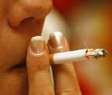
Background
Trends in smoking behaviors among adolescents and young adults have not paralleled the steady decline in smoking trends among US adult smokers.
Currently smoking rates are:
1.2% in the 12−13 year olds
13.6% in 16−17 year olds
31.8% in young adults (18–25 years of age)
USDHHS, The Health Consequences of Smoking—50 Years of Progress: A Report of the Surgeon General, in Chapter 13. Patterns of Tobacco Use Among U.S. Youth, Young Adults, and Adults 2014; Flay, B.R., Youth tobacco use: risks, patterns, and control. Nicotine addiction: Principles and management, 1993: p. 365-384; Addictive Behaviors, 1987. 12(4): p. 319-329.

Slide 3
Background
There are SES, environmental and psychosocial factors which increase the risk of experimentation and progression to smoking:
Lower socioeconomic status indicators
Peer exposure
Cigarette accessibility
Rebelliousness and antisocial behavior
Emotional distress/low self esteem
Use of other substances
Poor school achievement
family and school dis-connectedness
J Subst Abuse, 1992. 4(3): p. 219-34; Am J Prev Med, 1997. 13(3): p. 167-74; Addict Behav, 2002. 27(2): p. 227-40; Drug Alcohol Depend, 2002. 66(3): p. 303-14; Am J Public Health, 1998. 88(10): p. 1518-22; Addiction, 2002. 97(5): p. 517-31; J Subst Abuse, 1997. 9: p. 241-55; Addict Behav, 1995. 20(4): p. 517-24; Br J Addict, 1992. 87(12): p. 1711-24; JAMA, 1997. 278(10): p. 823-32

Slide 4
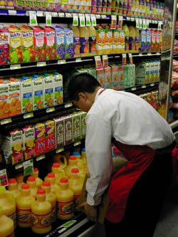
Background
The role that early employment exposures play in the risk of experimentation and progression to regular smoking in adolescence and young adulthood has produced mixed results for:
Employment status
Type of employment
Work intensity
Developmental Psychology, 1991. 27(2): p. 304-313; 1993. 29(2): p. 171-180; JOEM, 2011. 53(2): p. 196;Tob Control, 2005. 14(3): p. 181-5; Nicotine & Tobacco Research, 2007. 9(6): p. 687-697; Child Development, 1996. 67(3): p. 1243-1261.

Slide 5
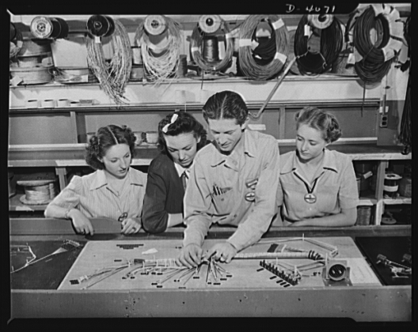
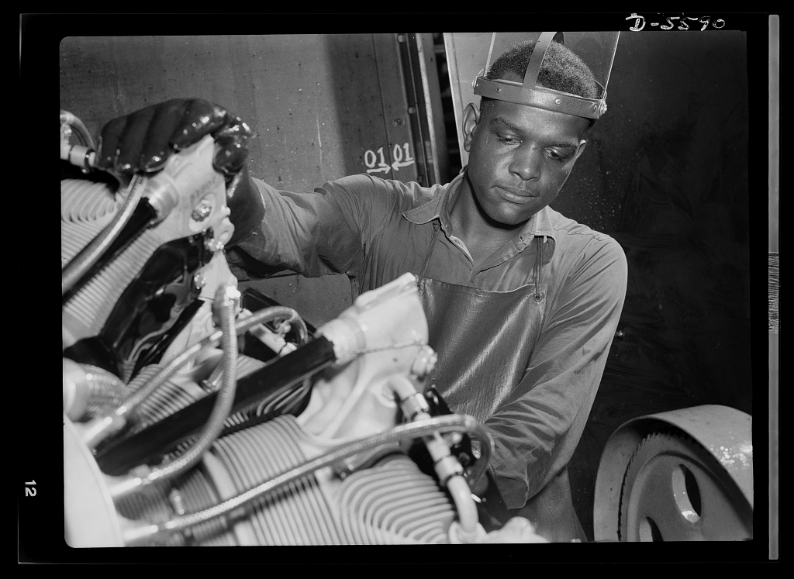
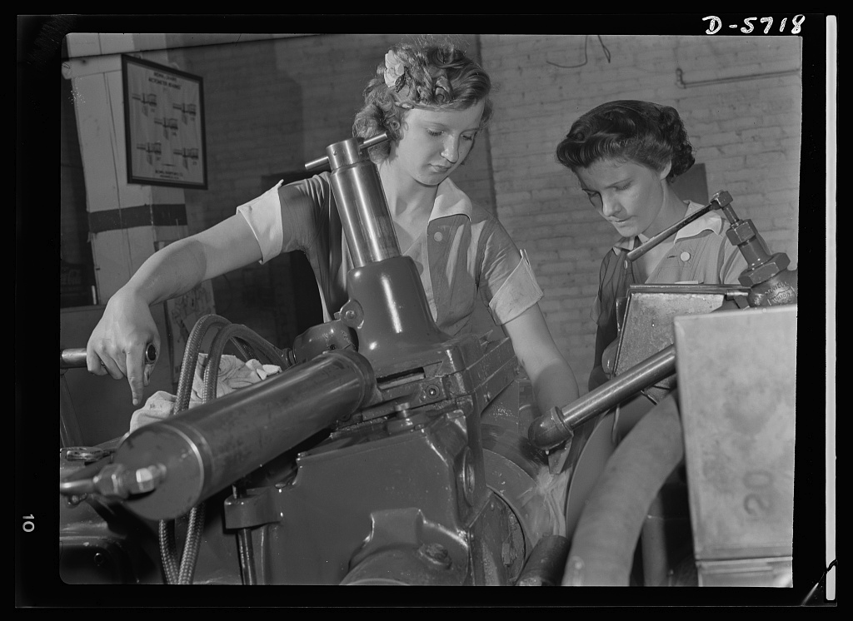
Objective
Taking a life course perspective we examine the effects of work characteristics on smoking behaviors among adolescents and young adults
http://www.loc.gov/pictures/item/oem2002002747/pp/
http://www.loc.gov/pictures/item/oem2002004311/pp/
http://www.loc.gov/pictures/item/oem2002004187/pp/

Slide 6
http://www.cpc.unc.edu/projects/addhealth/design/slideshow

Slide 7
http://www.cpc.unc.edu/projects/addhealth/design/slideshow

Slide 8
Definition of Outcomes
Time to first cigarette- “Have you ever tried cigarette smoking, even just 1 or 2 puffs?”
Yes= Smoking Experimentation
Current Smoker- “During the past 30 days, on how many days did you smoke cigarettes?”
1 or more days= current

Slide 9
Control Variables
Male sex
Age in years
Hispanic ethnicity
Race (black, Asian, other, white (reference))
Number of best friends who smoke at Wave I & II
Parent smoked at Wave I*
Parent income at Wave I* (100s of $)
Parent high school education at Wave I*
* parent report

Slide 10
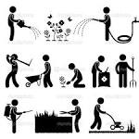
Work and Occupation Variables
Work status
Number of hours worked (units in 10 hours)
Number of hours worked squared (units in 10 hours)
First job in food service, sales related, other (reference)
Age at first job
Age at first full-time job

Slide 11
Analysis
All analyses were performed using MPLUS Version 6
Cox hazard models
Logistic regression using individual-by-time observations
ML for item missing data, assuming MAR
Weighted estimators (correcting for unequal selection)
Sandwich variance estimators (correcting for clustering and stratification)

Slide 15
Conclusions/Summary
Starting work at a younger age increases the likelihood of smoking in young adulthood.
The type of first job in adolescence (e.g., food service) may have lasting impacts on smoking behavior.
Increased weekly hours worked is the most ubiquitous work characteristic impacting smoking behavior in adolescents and young adults.
The effect of hours worked is essentially linear.

Slide 16
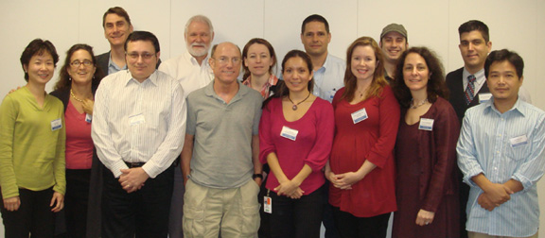
Acknowledgements
We wish to thank Symposium Chair Dr. Sara E. Luckhaupt, Medical Officer, National Institute for Occupational Safety and Health
Supported by the National Institute for Occupational Safety and Health (NIOSH R01 OH003915; R03 OH010124) and the National Institute of Child Health and Human Development (NICHD F32 HD059318)
AND
David Lee: dlee@med.miami.edu
Sara Luckhaupt: pks8@cdc.gov
Manuel Cifuentes: manuel_cifuentes@uml.edu
Alberto Caban: acaban@med.miami.edu
www.umiamiORG.com

