Slide 1

Linkage of O*NET with the National Health Interview Survey for Characterization of Worker Psychosocial Exposure
Manuel Cifuentes, MD, ScD
University of Massachusetts Lowell College of Health Sciences, Department of Work Environment

Slide 2
O*NET
Occupational Information Network
Developed under the sponsorship of the US Department of Labor/Employment and Training Administration (USDOL/ETA)
Through a grant to the North Carolina Department of Commerce.
From http://www.onetcenter.org/overview.html

Slide 3
O*NET description
“…nation's primary source of occupational information.”
“…O*NET database, hundreds of
  standardized and
  occupation-specific descriptors.”
The database is
  Public
  Free
  Continually updated by surveying workers from each occupation.
From http://www.onetcenter.org/overview.html

Slide 4
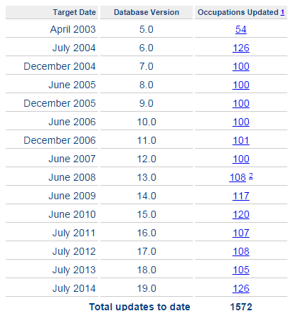
940 occupations have been comprehensively updated to date.
540 occupations have more than one update.

Slide 5

O*NET is most used for:
…exploring and searching occupations.

Slide 6
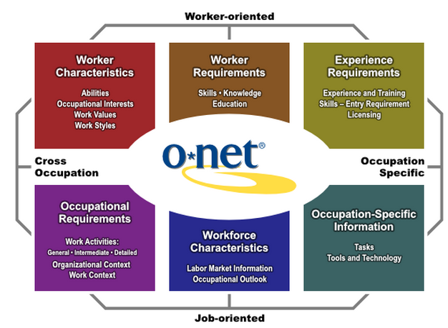
O*NET Content Model

Slide 7
Data collection
Random sample of businesses
  Random sample of workers
  Each worker answer one of three questionnaires.
Answers are entered (as averages or percentages) to the O*NET database.
Abilities and Skills filled by occupational analysts (using the updated information from incumbent workers)

Slide 8
Job Exposure Questions in O*NET
We found questions for:
  Psychological demands and control (job strain from Karasek’s model).
  Supervisor support.
  Coworker support.
  Rewards: salary satisfaction, prestige, job security (effort reward imbalance model!).
  Emotional labor.
And also there was information for many bio-mechanic exposure variables.

Slide 9
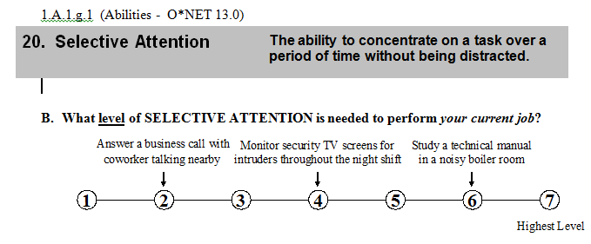
O*NET questions used to mimic psychosocial exposure models
We classified this question as a “psychological demand.”

Slide 10
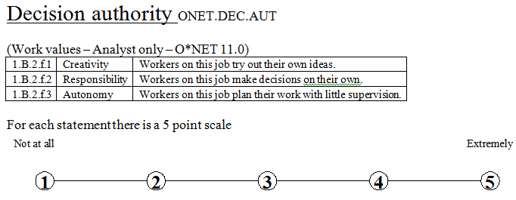
We classified these question as a “Control.”

Slide 11
O*NET ➔ Job level exposure matrix
Therefore, this information can be merged with databases containing job title.
But…
  O*NET uses 8 digits O*NET-SOC codes
  SOC codes are six digits
  NHIS uses four digits codes (Census occupation).

Slide 12



Path to merge NHIS with O*NET
O*NET Occupational Classification
(O*NET-SOC)
8-digit job code
Decisions
Standard Occupational Classification (SOC)
6-digit job code
Crosswalk
NHIS 4-digit Census job code

Slide 13


SOC codes are the same than O*NET SOC codes ignoring the last two digits (zeroes)
Easy merge!
Two or more O*NET SOC codes for each SOC code.
Some decisions required!

Slide 14
Census 4 digits (NHIS) to SOC cross-walk
!!!!!

Slide 15



NHIS
SOC
Easy merge
Decisions needed

Slide 16
NHIS
SOC
O*NET-SOC
Approach 1: pick one; the one with the largest proportion in the workforce.
Approach 2: average them all. Use the mean.
Approach 3: weighted average using their representation in the workforce.
When collapsing multiple O*NET-SOC codes in one SOC code, is that one SOC code going to be “green” or “not-green?”
Solution: it is going to be “mixed.”

Slide 17
Demand-Control Dimensions
passive vs. low strain
active vs. low strain
high strain vs. low strain
passive vs. active
passive vs. high strain
active vs. high strain
Model Covariates
age
sex
race
ethnicity
education
marital status
BMI category
health insurance status
U.S. region
white-collar job
blue-collar job
service job
farm job
smoking status
drinking status
exercise status
depression
hopeless
sad
effort
worthless

Slide 18
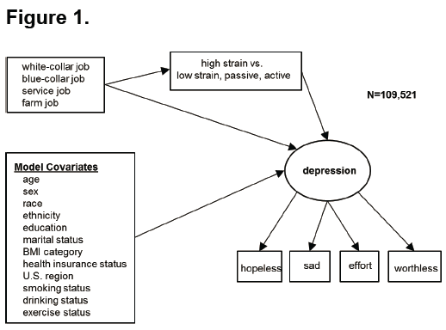
Merged O*NET with NHIS
From O*NET
From NHIS

Slide 19
Strain Model for All Workers (n = 109,521)
 | Self-Rated Poor Health |  | Depression
 | 1 to 5 scale |  | ~1 to 5 scale
 | Odds Ratio |  | β
passive v. low strain | 1.10 | *** | 0.08 | ***
active v. low strain | 1.00 |  | -0.01
high strain v. low strain | 1.08 | *** | 0.06 | ***
passive v. active | 1.10 | *** | 0.09 | ***
passive v. high strain | 1.02 |  | 0.02
active v. high strain | 0.92 | *** | -0.07 | ***
* p < 0.05, ** p < 0.01, *** p < 0.001
controls: age, sex, race, ethnicity, education, BMI categories, health insurance, region, krieger work sectors, smoking, drinking, exercise

Slide 20
Strain Model for White-Collar Workers (n = 59,387)
 | Self-Rated Poor Health |  | Depression
 | 1 to 5 scale |  | ~1 to 5 scale
 | Odds Ratio |  | β
passive v. low strain | 1.10 | *** | 0.07 | ***
active v. low strain | 0.98 |  | -0.01
high strain v. low strain | 1.12 | *** | 0.06 | **
passive v. active | 1.12 | *** | 0.09 | ***
passive v. high strain | 0.98 |  | 0.02
active v. high strain | 0.87 | *** | -0.07 | **
* p < 0.05, ** p < 0.01, *** p < 0.001
controls: age, sex, race, ethnicity, education, BMI categories, health insurance, region, smoking, drinking, exercise

Slide 21
N=109,521
passive
0.68***
0.04***
service
(vs. white-collar)
0.04*
depression
Indirect effect service: 0.03***
controls: age, sex, race, ethnicity, education, BMI categories, health insurance, region, smoking, drinking, exercise

Slide 22

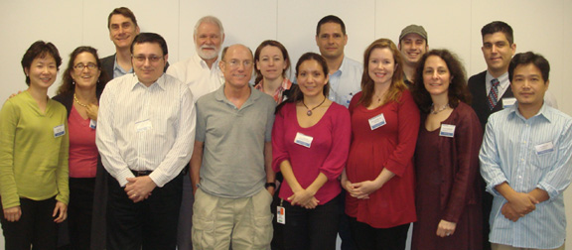
Acknowledgements
We wish to thank Symposium Chair Dr. Sara E. Luckhaupt, Medical Officer, National Institute for Occupational Safety and Health
Supported by the National Institute for Occupational Safety and Health (NIOSH R03 OH010124 and R01 OH003915) and the National Institute of Child Health and Human Development (NICHD F32 HD059318)
AND

