Slide 1
Total Worker Health Surveillance in the US Workforce
David J. Lee, PhD
University of Miami Miller School of Medicine
Department of Public Health Sciences

Slide 2
Total Worker Health™ is a strategy integrating occupational safety and health protection with health promotion to prevent worker injury and illness and to advance health and well-being
Approach brings with it increased emphasis on stress management, organizational change and health behavior change
Workplace stress associated with:
smoking
heavy drinking
poor food choices
low levels of exercise
decreased sleep time
http://www.cdc.gov/niosh/twh/
http://www.nap.edu/catalog.php?record_id=18947
JOEM 2012; 55 (12 Suppl) S25-S29

Slide 3
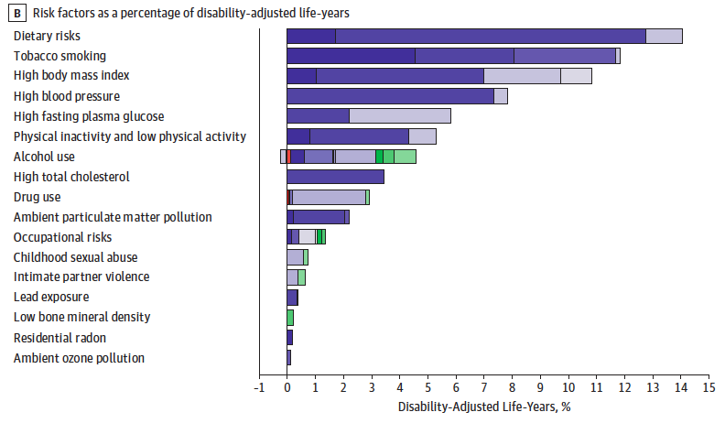
Behavior Drives Health
Jama: US Burden of Disease Collaborators, 2013
Notes:
Green=injuries
Purple=chronic
Red= communicable

Slide 4
Total Worker Health™ evaluation must happen at the worksite level and at the national level
National surveillance provides “big-picture” views
Monitor trends in health behaviors/outcomes
Benchmarking (e.g., Healthy People 2020)
Document reductions in health disparities
Identify emerging public health issues
Prioritize limited funding

Slide 5
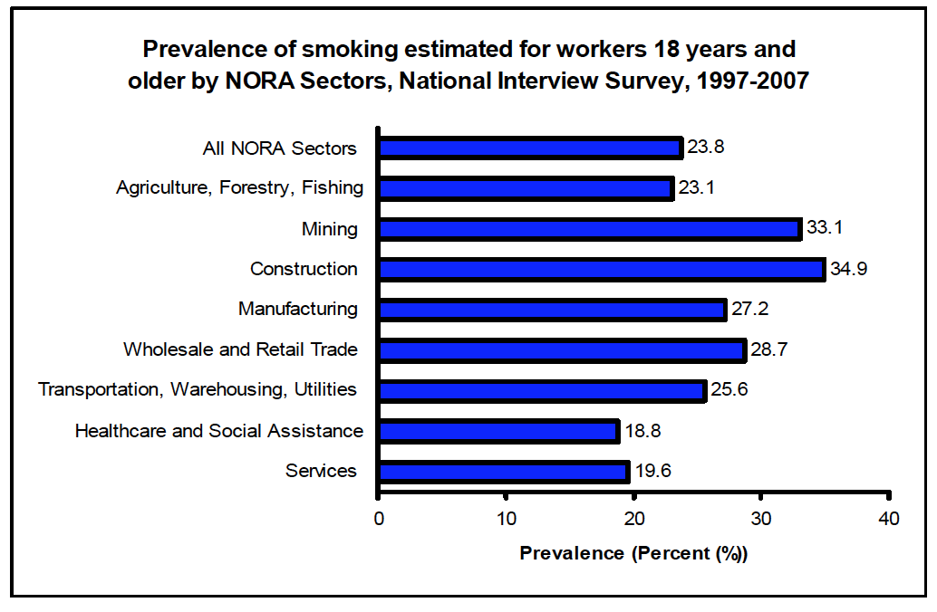
http://www.cdc.gov/niosh/docs/2012-160/

Slide 6
Objective
Overview of population-based surveillance systems which can inform Total Worker Health™ initiatives
None of the these systems specifically designed for this task
Use of multiple data sources can overcome limitations for comprehensive monitoring

Slide 11
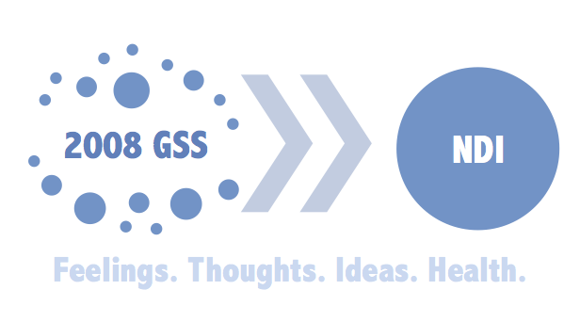
Other data sources
Health and Retirement Survey
National Longitudinal Surveys of Youth
General Social Survey
https://ssl.isr.umich.edu/hrs/reg_pub2.php
https://www.nlsinfo.org/investigator/pages/login.jsp
http://www3.norc.org/GSS+Website/Download/
http://gss-ndi.blogspot.com/

Slide 12
Other data sources
Behavioral Risk Factor Surveillance System
Gallup daily tracking
National Longitudinal Mortality Study (NLMS)
http://www.cdc.gov/brfss/annual_data/annual_data.htm
http://www.gallup.com/poll/110380/How-does-Gallup-Daily-tracking-work.aspx
https://www.census.gov/did/www/nlms/publications/docs/referenceManual.pdf

Slide 13
Conclusions
Existing health surveillance network can be utilized to inform Total Worker Health initiatives throughout the worker life course
Linkage with these surveys extends their value
Additional work is needed to further enhance surveillance resourses
TWH supplements
Linkage with claims data and worker compensation data
http://www.cdc.gov/brfss/annual_data/annual_data.htm
http://www.gallup.com/poll/110380/How-does-Gallup-Daily-tracking-work.aspx
https://www.census.gov/did/www/nlms/publications/docs/referenceManual.pdf

Slide 14
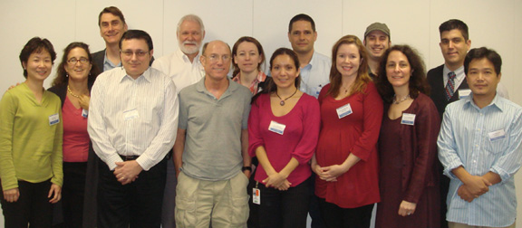
Acknowledgements
We wish to thank Symposium Chair Dr. Sara E. Luckhaupt, Medical Officer, National Institute for Occupational Safety and Health
Supported by the National Institute for Occupational Safety and Health (NIOSH R01 OH003915 and R03 OH010124) and the National Institute of Child Health and Human Development (NICHD F32 HD059318)
AND

