Slide 1
Multi-Survey Linkage for the Calculation of Occupation-Specific Quality-Adjusted Life Years (QALYs) in the US Workforce
Alberto J. Caban-Martinez, DO, PhD, MPH
University of Miami Miller School of Medicine, Department of Public Health Sciences

Slide 2
Background
Adults aged 65 years and older:
Fastest growing demographic group
Projected to almost double between the present day and 2050, rising from 6% to 11%
1 in 5 of these elderly are poor
Proportion of employed workers aged 65 years and older is increasing.
Increasing health costs reducing retirement savings, and place financial burden on the elderly.
Hobbs et al. 65+ in the United States. Washington, DC: US Department of Commerce, Economics and Statistics Administration, 2006; Rowland et al. Medicare, Medicaid, and the elderly poor. Health Care Financ Rev. 1996;18(2):61–85; Older workers [Bureau of Labor Statistics Web page]. 2008. Available at: http://www.bls.gov/spotlight/2008/older_workers.

Slide 3
Background
Blue-collar and elderly more likely than younger or more affluent people to suffer from disabling conditions and live shorter lives.
Arthritis:
Lens to view the convergent social phenomena of aging, workforce globalization, health costs, and falling quality of life among the middle and lower classes.
Ghilarducci et al, Work Options for Older Americans. Notre Dame, IN: University of Notre Dame Press, 2007; Work. 2006;27(4):391–396; Arthritis Rheum. 2005;53(3):328–336; Arthritis Rheum. 2006;54(1):226–229; Arthritis Rheum. 2007;57(7):1269–1279; Arthritis Rheum. 2007;57(5):738–747

Slide 4
Study Objective
Use the burden of disease attributable to arthritis by occupational class to illustrate the challenges faced by the older poor.

Slide 5
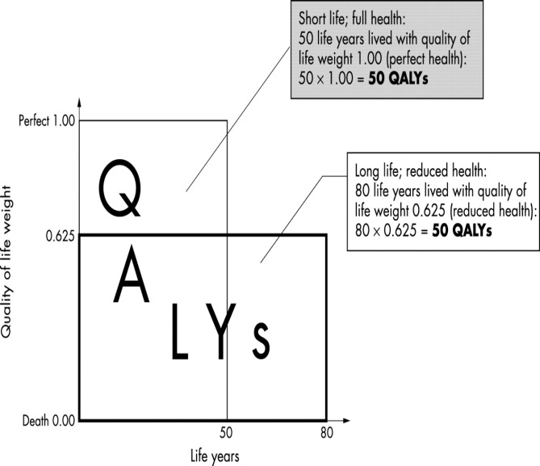
Approach
Quality-Adjusted Life Year (QALY)
Main Outcome Measure
Two dimensions:
Time spent alive
One's health-related quality of life (HRQoL)
Scaled from 0 (death) to 1 (perfect health) and can be used to adjust the amount of time lived in good health to reflect relatively higher or lower morbidity
Am J Manag Care. 2007;13(Suppl 9):S218–S223

Slide 6
Approach
3-step process to estimate quality-adjusted life expectancy (QALE) and to calculate incremental QALYs arising from arthritis
Estimate mean EQ-5D scores and mortality probabilities in 1-year age intervals by occupational class.
Used mortality probabilities and these scores to build life tables for each occupational class.
Subtract QALE by occupational class at different age intervals - difference between QALE values yields the incremental QALYs.
Anderson RN., US National Center for Health Statistics ,Method for constructing complete annual U.S. life tables. Hyattsville, MD 1999

Slide 7
Study Databases Employed
1997– 2004 National Health Interview Survey (NHIS)
Annual population-based survey of the resident non-institutionalized US civilian population.
Family and Adult Core
2001–2003 Medical Expenditure Panel Survey (MEPS)
Linked EQ-5D scores (a health-related quality of life measure) from the NHIS responders that participated in MEPS.
Linked data from the NHIS to mortality data from the National Death Index to estimate the probability of death.

Slide 8
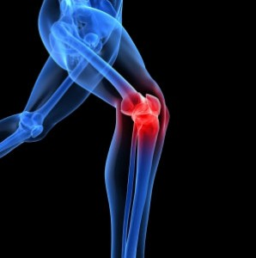
Occupational and Arthritis classification
Occupation for the week preceding the NHIS interview.
Workers grouped according to 2000 Standard Occupational Codes into four major occupational groups:
white-collar, Service, Farm and blue-collar workers
NHIS, arthritis status adults aged 18 years and older assessed by question: “Have you EVER been told by a doctor or other health professional that you have some form of arthritis, rheumatoid arthritis, gout, lupus, or fibromyalgia?”
Data file documentation, National Health Interview Survey, 2000. Hyattsville, MD: National Center for Health Statistics; 2002; Med Care. 2003;41(7 Suppl):III5–III12

Slide 9
Health-related quality of life measure
Derived from EQ-5D measure in MEPS.
Five-items measuring each 5 dimensions of health status (mobility, self-care, usual activities, pain or discomfort, and anxiety or depression)
Three-levels per dimension (no problem, some problems, and extreme problems)
Score function, an EQ-5D index score based on responses to the 5-item questionnaire provided in MEPS.
Preference scores measured on scale from 0 to 1
0 represents death
1 represents perfect health
Pharmacoeconomics. 2000;17(1):13–35; Med Care. 2005;43(3):203–220

Slide 10
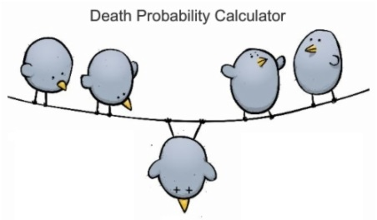
Estimating Probability of Death
Calculate age- and occupation-specific probabilities of death by arthritis status by using the NHIS linked with the National Death Index.
Pooled data from the 1997–2004 NHIS linked with pooled NDI 1997–2004 (with follow up through 2006) mortality data.
Study time period:
16,965 deaths among the 242,223 NHIS-participating adults.
Calculate probability of death for all adults aged 18 to 88 years by arthritis status and occupational class by using coefficients from these pooled logistic regression models.
Pharmacoeconomics. 2000;17(1):13–35; Med Care. 2005;43(3):203–220

Slide 11
Quality-adjusted Life Expectancy Measure
Construct total of 8 life tables in 1-year age intervals with US mortality data for each of the occupational classes (white-collar, service, farm, and blue-collar workers) by arthritis status.
QALE at age a is:
Calculating incremental QALYs.
Pharmacoeconomics. 2000;17(1):13–35; Med Care. 2005;43(3):203–220

Slide 12
Notes:
Overall, workers with arthritis reported EQ-5D scores that were lower (0.69; 95% confidence interval [CI] = 0.67, 0.70) than those of workers without arthritis (0.88; 95% CI = 0.87, 0.89). In all cases, we found that white-collar workers with arthritis suffered considerably less overall morbidity (relative to those without arthritis) than did other workers. For instance, whereas white-collar workers with arthritis realized a 10% drop in their EQ-5D score (from 0.84 to 0.72), service workers realized more than a 20% drop in their EQ-5D score (0.88 to 0.64).

Slide 13
Quality-adjusted life expectancy for worker with and without arthritis
Notes:
Although morbidity provides much of the story, it is also informative to explore the remaining healthy life expectancy at age 65 years, or QALE. This is a measure of the quality time remaining for workers of different occupational classes. Figure 1 presents the QALE remaining among white-collar, service, farm, and blue-collar workers with arthritis at 2 different ages: 25 and 65 years. At age 25 years, blue-collar workers without arthritis can expect to live 44 years of perfect health over their remaining life, and white-collar workers without arthritis can expect to live 50. Among those with arthritis, QALE is 33 and 39 respectively. Said another way, if 25-year-old white collar workers without arthritis represent the ideal standard, then 25-year-old blue collar workers suffer the equivalent of 17 years of perfect health lost. At age 65 years, white-collar workers with arthritis who remain in the workforce can expect to lose just 4 QALYs relative to those without arthritis, whereas blue-collar workers lose nearly 6 of their remaining years of perfect health measured in QALYs.

Slide 14
Summary / Conclusions
Arthritis serves as a powerful lens for looking at these convergent phenomena.
Lower-income workers of older age in the service and farming sectors—more likely to have arthritis than not (58% and 67%).
Linking multi-survey data allows for powerful investigations into the effect of QALYs on disease morbidity by occupational groups.

Slide 15
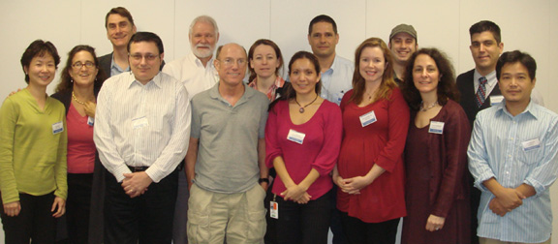
Acknowledgements
This study was supported in part by the National Institute of Arthritis and Musculoskeletal and Skin Diseases (grant F31AR057687) and the National Institute for Occupational Safety and Health (grant R01 OH003915).
Contact Email: acaban@med.miami.edu

